Slide 1


Joshua Jonathan
SME: Gulshana Chaudhary

Slide 2
Fake News Report
Fake News Filtering
Fake news has become one of the biggest problems of our age. It has a serious impact on our online as well as offline discourse. One can even go as far as saying that, to date, fake news poses a clear and present danger to western democracy and stability of the society.
Fake news's simple meaning is to incorporate information that leads people to the wrong path. Nowadays fake news spreading like water and people share this information without verifying it. This is often done to further or impose certain ideas and is often achieved with political agendas.
For media outlets, the ability to attract viewers to their websites is necessary to generate online advertising revenue. So it is necessary to detect fake news.
Data Set Description
There are two datasets one for fake news and one for true news. In true news, there is 21417 news, and in fake news, there is 23481 news. I have inserted one label column zero for fake news and one for true news:
Title: Headlines of the news.
Text: Content of the news.
Subject: Subject of the news.
Date: Date of the news.
Label: News is True(1)/False(0)

Slide 3



Model Building Phase
After collecting the data, you need to build a machine learning model. Before model building do all data pre-processing steps. Try different models with different hyper parameters and select the best model.
Follow the complete life cycle of data science. Include all the steps like
1. Data Cleaning
2. Exploratory Data Analysis
3. Data Pre-processing
4. Model Building
5. Model Evaluation
6. Selecting the best model
EDA
SHAPE OF THE DATASET.
INFORMATION OF THE DATASET.
DATA CLEANING.

Slide 4
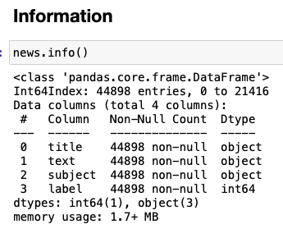
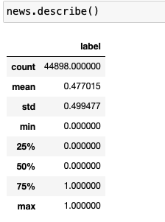
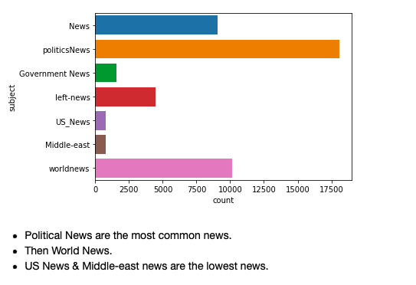
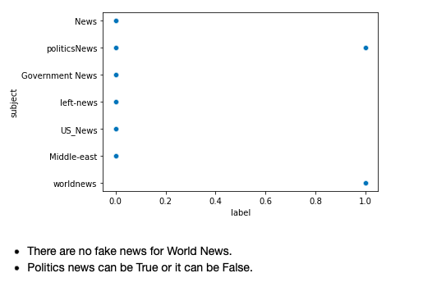
Descriptive Statistic:
Information of dataset:-
Visualization:

Slide 5
Natural Language Processing (NLP)
Data Preprocessing
Stopwords
Punkt
wordnet
Converting to lower case
Removing the URL's
Removing the numbers
Dealing with Punctuation
Removing Stop word
Applying Lemmatization

Slide 6
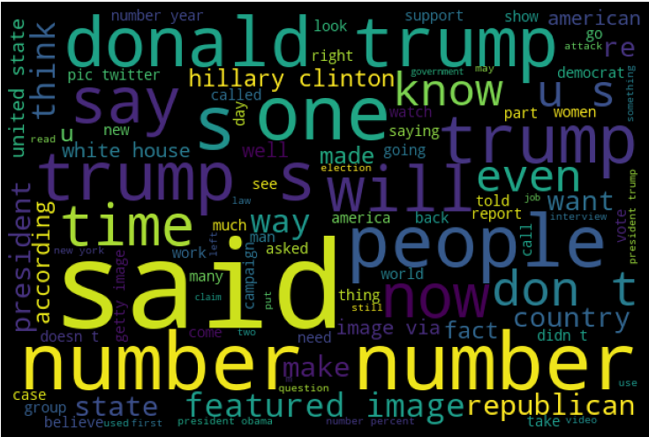
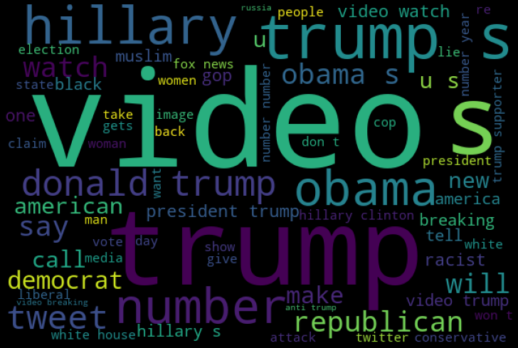
Length before and after preprocessing
Original Length : 110858087
Clean Length :
78875097
Word Cloud
Text Column
Title Column

Slide 7
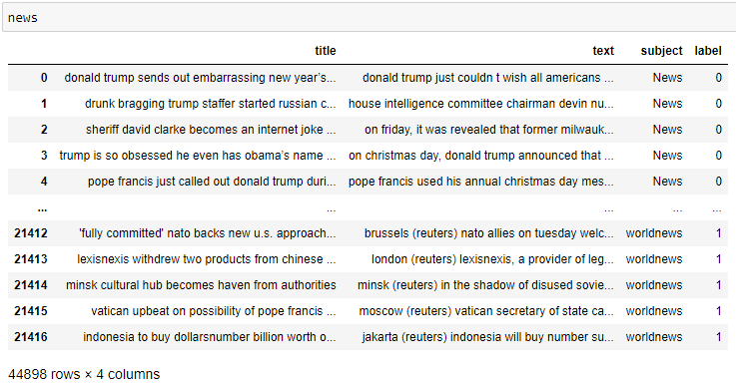
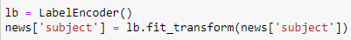
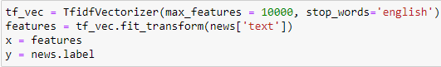
Final Dataset
Encoding TF-IDF Vectorizer

Slide 8
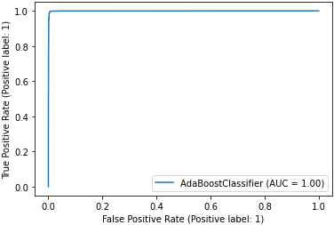
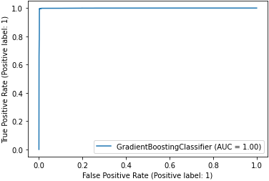
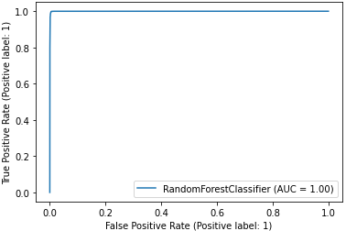
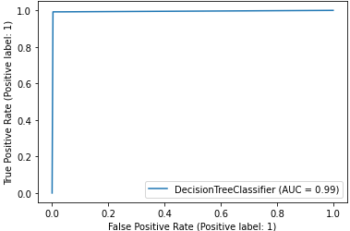
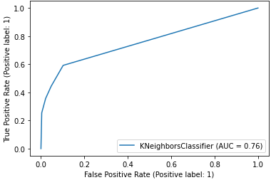
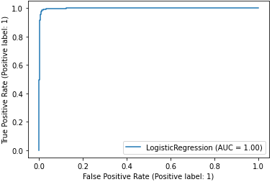
AdaBoost Classifier
GradientBoosting Classifier
RandomForest Classifier
DecisionTree Classifier
KNeighbors Classifier
Logistic Regression
Every Model is working fine except the KNeighborsClassifier, and we are selecting the RandomForestClassifier as it is giving the best score.

Slide 9
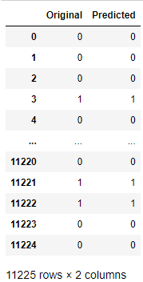
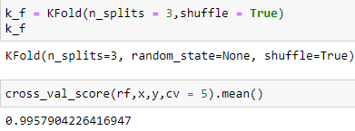
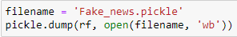
Original VS Predicted
Cross-Validation
Saving the Model

Slide 10


